Slide 1
How the Law of Large Numbers brings oroer to a random world
G NoI ebookLM

Slide 2

The Anarchy
of One
A single coin flip is pure chance. Its outcome is entirely unpredictable. Heads or tails? We have no way of knowing.
This is the world of individual,
random events.
1 (Heads)
Heads
0 (Tails)
G NotebookLM

Slide 3
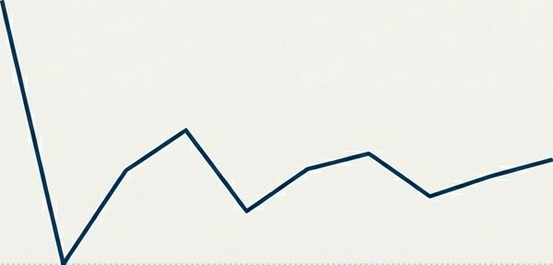
The Deception of a Small Sample
With just ten flips, the results can be deceptive. We might see
70%
o.6
seven heads and three tails a
70% proportion. Is the coin biased? With such limited data, the story is incomplete and often wrong.
0.4
0.2
0.0
5 6
Number Of Flips
1
2
3
4
7
8
9 10
G NotebookLM

Slide 4
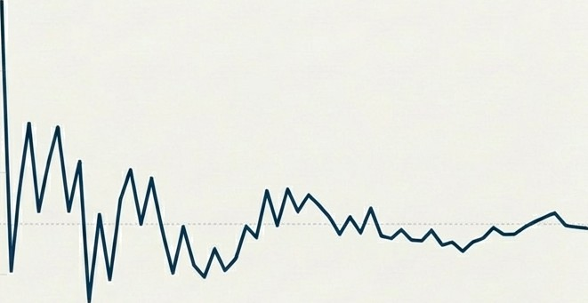
The First Glimmer
of a Pattern
As the number of trials increases to one hundred, the initial chaos begins to subside. The proportion of heads is now closer to the expected 50%, but stilt fluctuates. A true signal is starting to emerge from the noise.
8
0.6
0.4
0.2
0.0
0
40 60
Number of Flips
20
80
100
G
NotebookLM

Slide 5
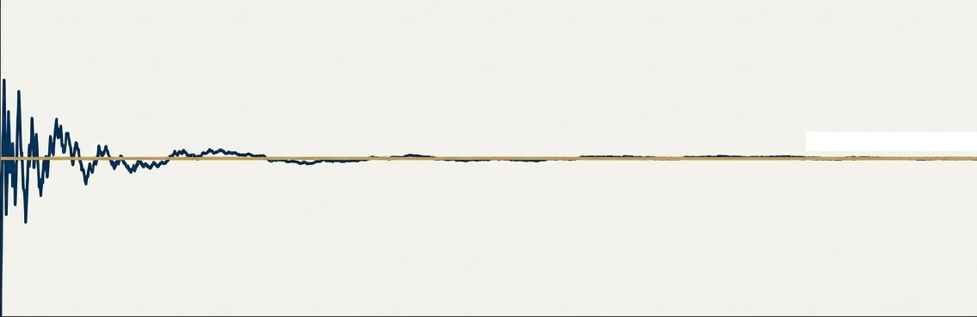
The Inevitability of Truth
1.0
Expected Value: 50%
0.5
0.0
0
2000
4000
6000
8000
10000
Number of Flips
After ten thousand flips, the fluctuations become negligible. The proportion of heads converges with near-perfect precision on its true probability of 50%. The unpredictability of the single flip is overcome by the certainty of the multitude.
G
NotebookLM

Slide 6

This is the Law of Large Numbers
This powerful phenomenon is a fundamental principle of probability
and statistics. It states that:
The average of results from a large number of trials will converge
towards the expected value.
As the number of observations increases, the sample mean gets
closer to the true population mean.
G
NotebookLM

Slide 7
From Randomness to Reliability
The Law of Large Numbers is the engine that converts random, individual events into reliable, predictable outcomes. It is this principle that allows us to forecast, plan, and build systems in a world that is inherently uncertain.
G
NotebookLM

Slide 8



The Bedrock of Modern Industry
This principle is not merely academic. It is crucial in fields that manage immense risk and shape our future, providing a reliable basis for predictions and risk assessment.
Finance
Insurance
Scientific Research
G NotebookLM

Slide 9
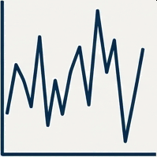
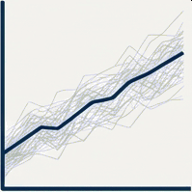

The Economics of Predictability
Insurance Finance
An insurer cannot predict if a specific house will have a fire. But with data on millions of homes, they can use the Law of Large Numbers to accurately forecast the total number of claims, allowing them to set viable premiums.
A single stock is unpredictable. By diversifying a portfolio across many assets, investors rely on the law to ensure the average return of the group is far more stable and predictable than the performance of any single component.
G NotebookLM

Slide 10
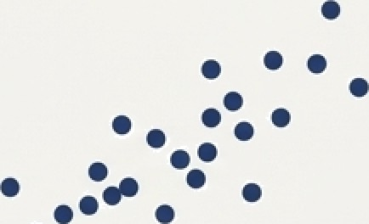

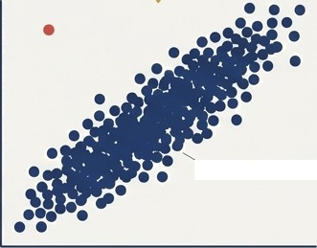
The Foundation of Evidence
.
A Single Outlier (Fluke?)
In scientific research, the law is
what separates a fluke from a finding. A result from a single experiment might be due to chance. Only when results are replicated across a large number of trials does statistical evidence emerge, confirming a hypothesis.
.
•
A Large Sample (Finding)
G NotebookLM

Slide 11

Evidence Over Chance
The Law of Large Numbers empowers us to make more informed decisions based on statistical evidence, rather than individual chance.

Slide 12


